Slide 1
OOPL Mini Project

Slide 2

Team Mates:
1019123 : Shweta Ghodake
1019146 : Aaditee D. Pate
1019154 : Shreya Sapale
1019167 : Aakash Yadav

Slide 3
OBJECTIVE
To develop an application in Java using Android Studio implementing the various concepts grasped in the CSL304 Skill based Lab Course: Object Oriented Programming with Java

Slide 4

PROBLEM STATEMENT
Developing a drums app that on tapping on specific instrument produces sound identical to the one developed while playing original instrument.

Slide 5


OUR SOLUTION:
We used the MEDIAPLAYER CLASS in Android Studio to play Sounds on clicking the image.
We used Vector Graphics to add vector instruments used in the Drums.
For the Music Files we used the stock Music Files.

Slide 6

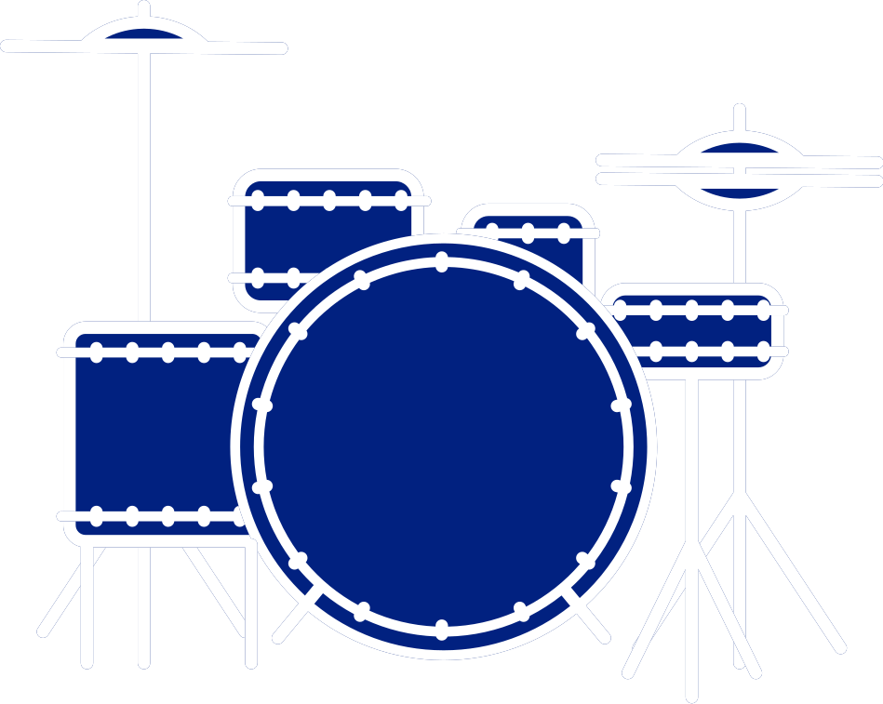

FEATURES OF OUR SOLUTION:
Cymbal
Mounted Toms
Cymbal
Floor Tom
Snare Drum
Bass drum

Slide 7

FUNCTIONALITY :
Each part of the drum kit has its own distinct sound
The precursor of the sound is the button located on the different parts of the drum kit, on pressing them the sound generates.

Slide 8
DRUMS APP
DRUMS APP

Slide 9
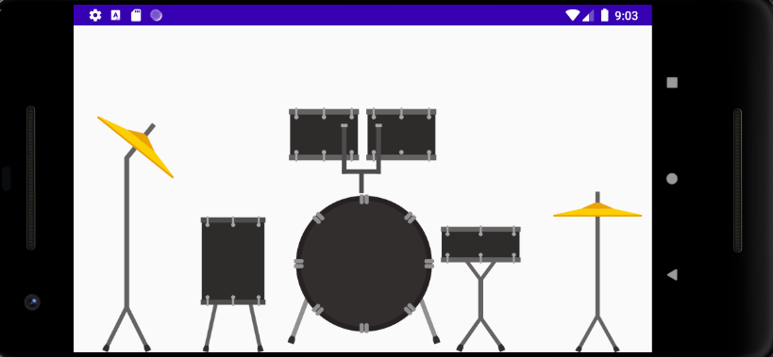
SCREEN SHOTS

Slide 10
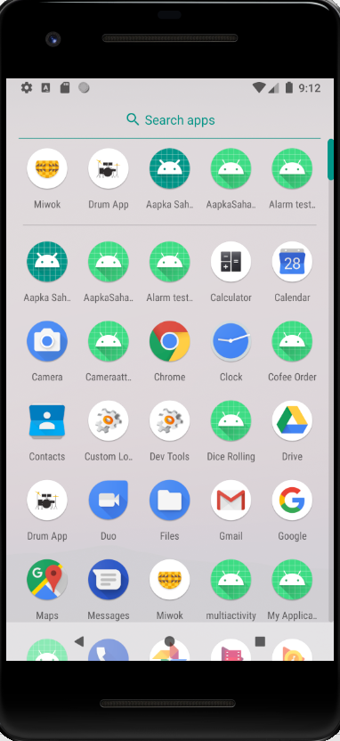

Slide 11
DEMO IN AVD MANAGER

Slide 12
Thank You 😸

